Slide 1


Stack machine ISA
CSE360 - Computer architecture
Spring - 2025

Slide 2

machine
Stack
Group - 07
  Md.Rabbi - 2022-2-60-067
  Saheba Akter - 2022-2-60-023
  Shahriar Khan - 2022-3-60-016 (31)
  Mohua Akter - 2022-3-60-112 (36)
Submitted to,
Problem statement
Dr. Md. Nawab Yousuf Ali
Professor, Department of Computer Science and Engineering
ISA

Slide 3
Problem statement
We built a stack machine that can do basic stack operations
for example
  PUSH

Slide 4
Problem statement
We built a stack machine that can do basic stack operations
for example
  PUSH
  POP

Slide 5
Problem statement
We built a stack machine that can do basic stack operations
for example
  PUSH
  POP
  ADD
  SUB
  MUL
  DIV
  infix to postfix
  postfix to infix
Flow chart

Slide 6
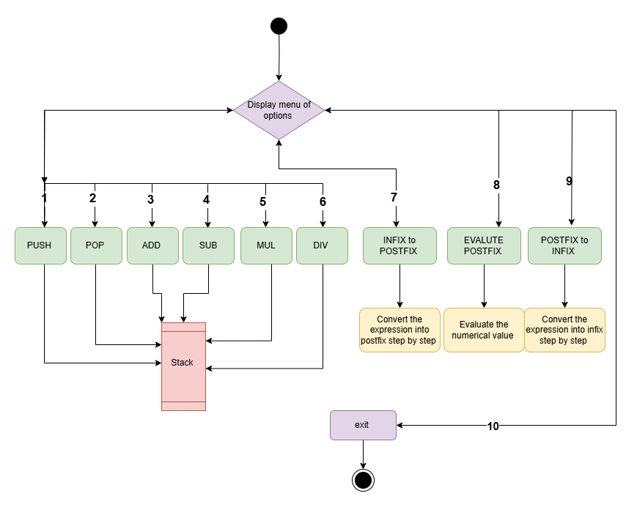
Problem statement
Flow chart
Libraries and features

Slide 7
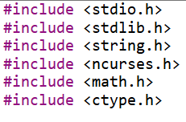
Libraries and features
text-based user interface To beautify and add more colors
Header files
Flow chart
character classification and manipulation

Slide 8
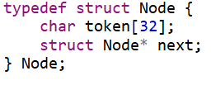
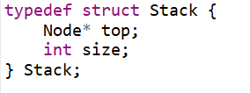
Libraries and features
Key Components
Data Structures
Node: Represents an element in the stack, storing a token and a pointer to the next node.
Stack: Represents the stack itself, with a pointer to the top node and a size indicator.

Slide 9
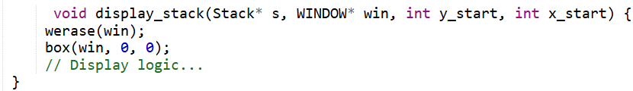
Libraries and features
Key Components
UI Functions:
Display Stack: Shows the current contents of the stack in a specified window.

Slide 10
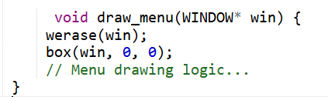
Libraries and features
Key Components
UI Functions:
Draw Menu: Renders the main menu with available options for the user.

Slide 11
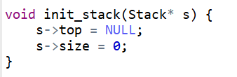

Libraries and features
Key Components
Stack Operations:
Initialize Stack: Sets up an empty stack by initializing the top to `NULL` and size to `0`.
Check if Stack is Empty: Returns `1` if the stack is empty, otherwise `0`

Slide 12
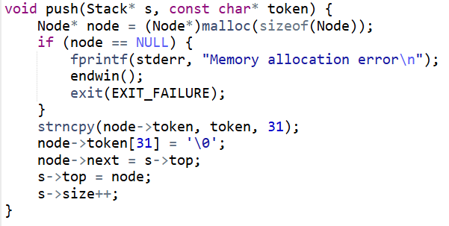
Libraries and features
Key Components
Stack Operations:
Push Operation: Adds a new token to the top of the stack, increasing its size.

Slide 13
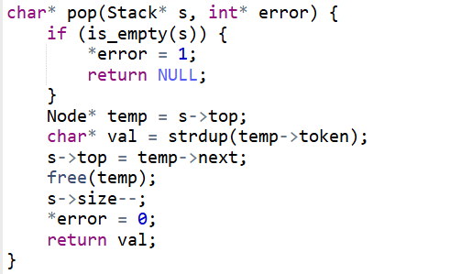
Libraries and features
Key Components
Stack Operations:
Pop operation: Removes and returns the top token from the stack, decreasing its size.

Slide 14
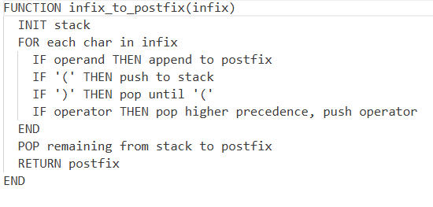
Libraries and features
Key Components
Conversion Functions:
Infix to Postfix Conversion:
Converts an infix expression to
postfix, displaying each step
in a message window.

Slide 15
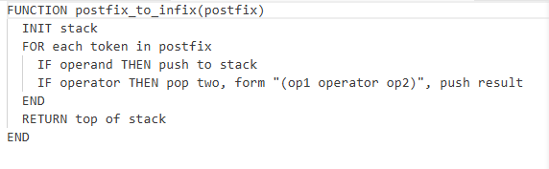
Libraries and features
Key Components
Conversion Functions:
Postfix to Infix Conversion: Converts a postfix expression to infix, displaying each step in a message window.

Slide 16
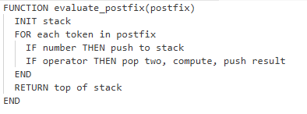
Libraries and features
Key Components
Evaluate Postfix Expression:
Evaluates a numeric postfix expression and stores the result.

Slide 17
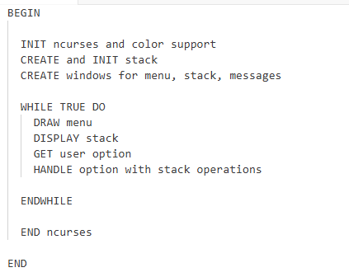
Workflow of the Program
Libraries and features
Key Components
Main Function:
Program Initialization and Loop:
Initializes the `ncurses` environment,
sets up windows, and enters the main
loop for user interaction.

Slide 18
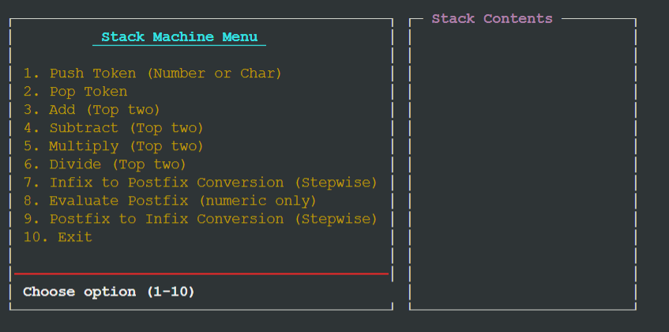
Workflow of the Program
Initialization:
The program initializes the ncurses
environment and sets up color pairs for UI elements.
It creates windows for the menu, stack display, and message output.
Libraries and features

Slide 19
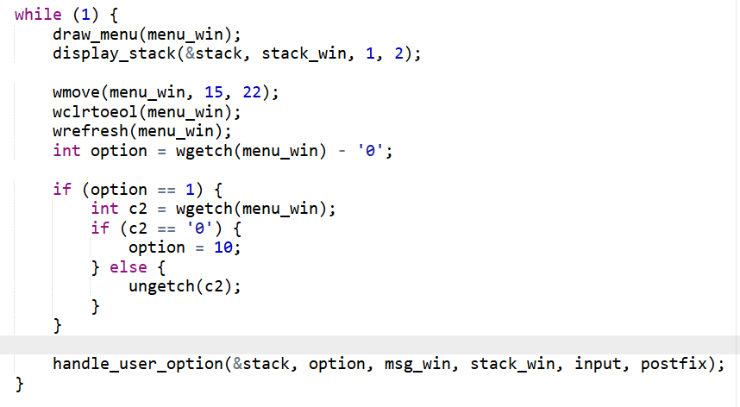
Output:
Workflow of the Program
Main loop:
The program enters a loop where it continuously displays the menu and waits for user input.
The user selects an option from the menu, which triggers the corresponding operation.

Slide 20
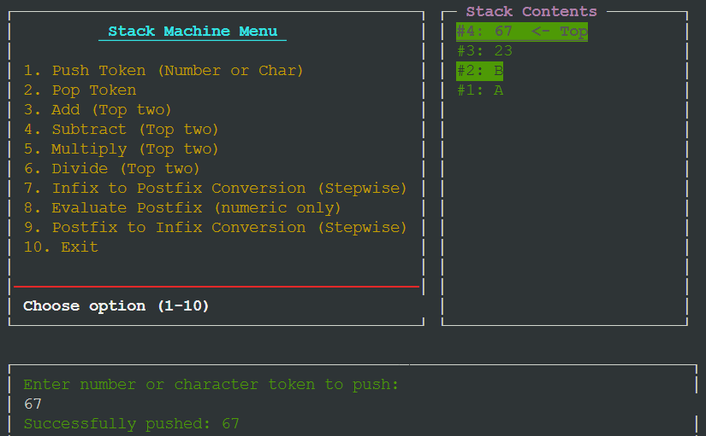
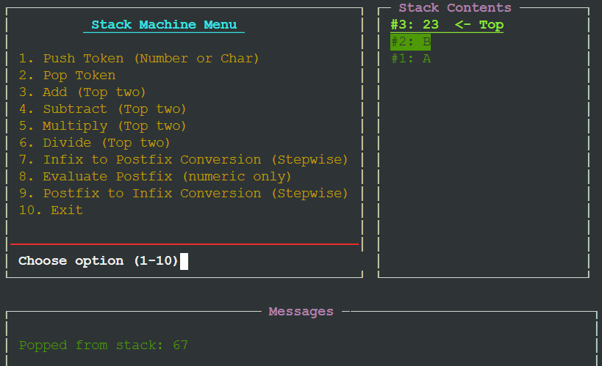
Output:
PUSH
POP
Pushed 4 values A, B, 23, 67
Popped the last element, in this case 67
Workflow of the Program

Slide 21
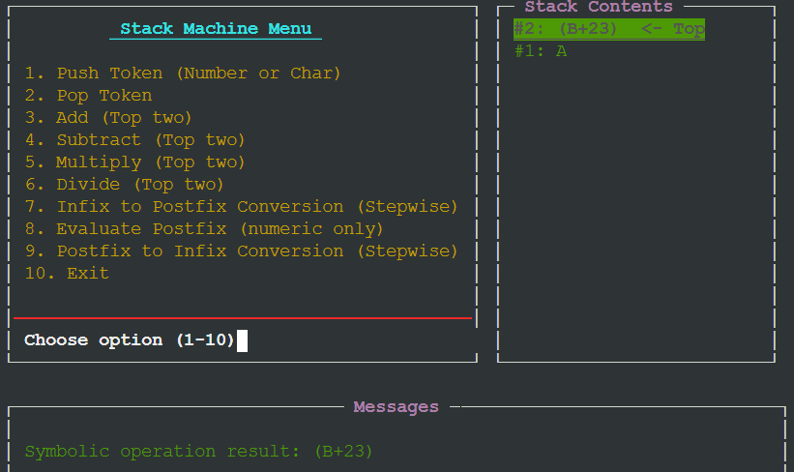
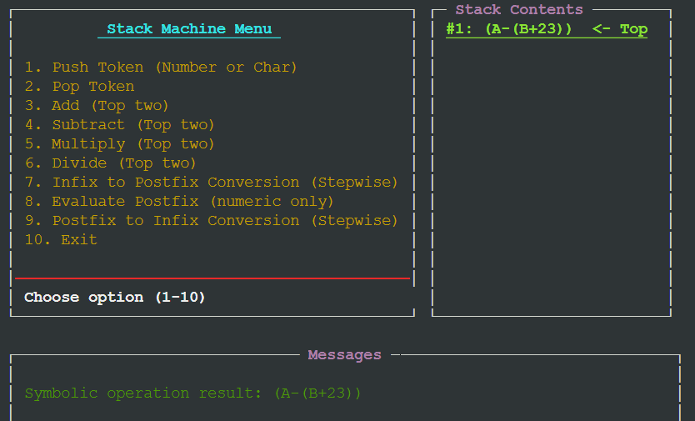
Output:
ADD
SUBTRACT
Added top two values , in this case B and 23
Subtracted top two values, in this case (B+23) from A

Slide 22

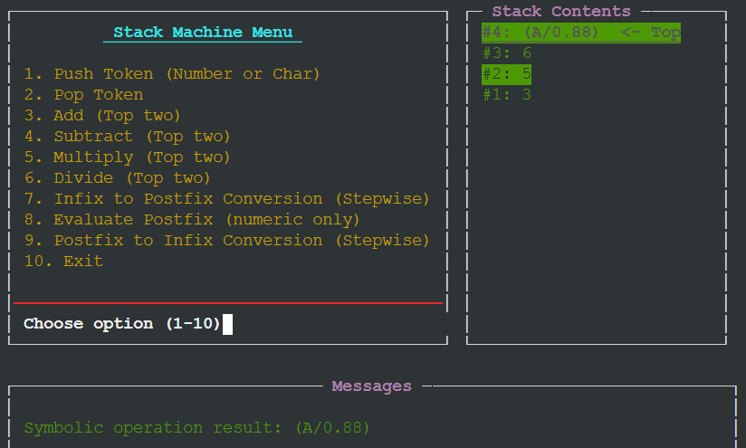
Output:
MULTIPLY
DIVIDE
Divide 2nd top value from the top value, in this case A and 0.88
Multiplies top two values , in this case 4 and 5

Slide 23
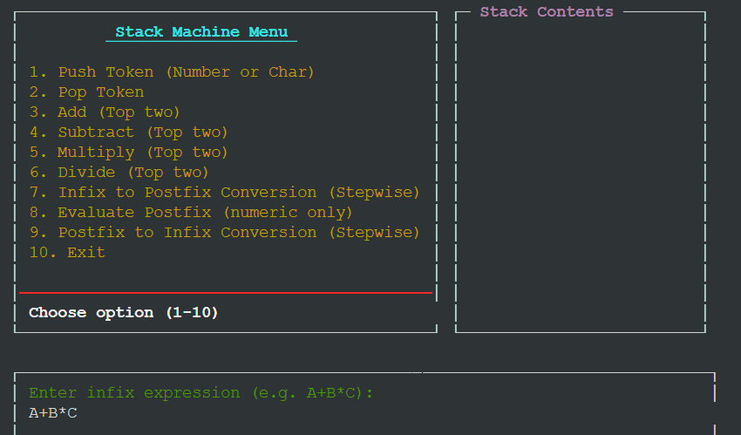
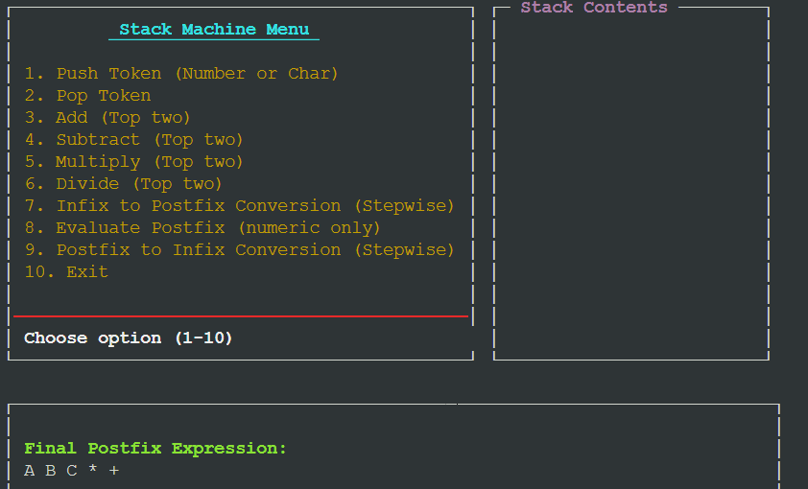
Output:
INFIX to POSTFIX
User Gives an expression then the program shows the postfix expression step by step
. . .

Slide 24
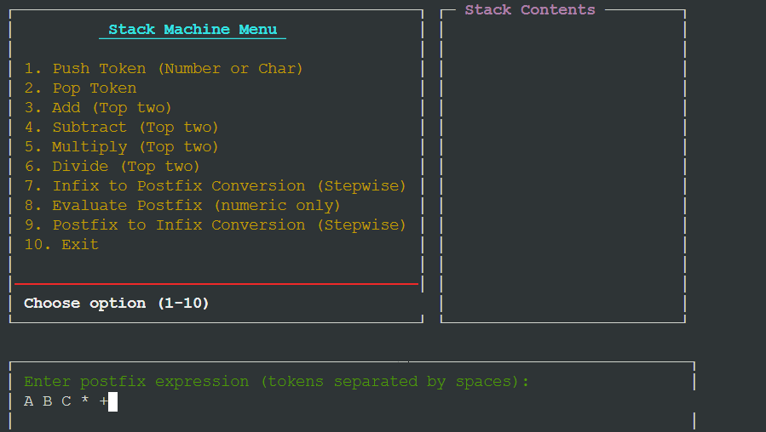
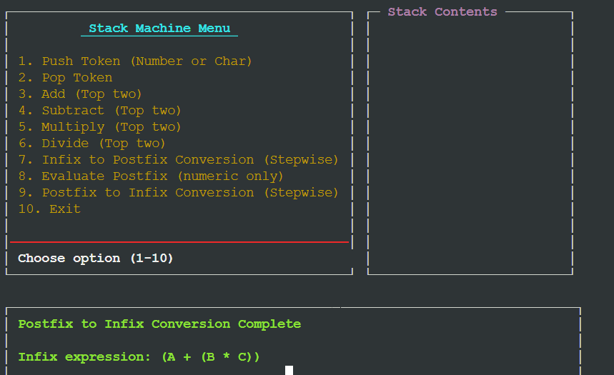
Output:
POSTFIX to INFIX
User Gives an expression then the program shows the infix expression step by step
. . .

Slide 25
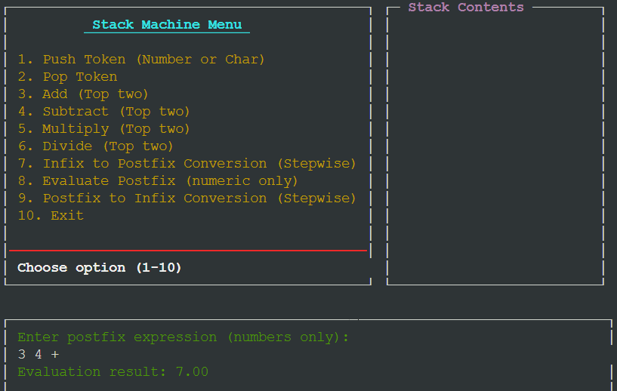
Output:
Evaluate POSTFIX(numeric )
Evaluate numerical postfix expression to result
Importance:

Slide 26
Output:
Importance:
Complexity: Managing deeply nested expressions can be difficult.
Precedence and Associativity: Ensuring correct operator precedence and associativity requires careful handling.
Error Handling: Basic implementations may not handle errors gracefully, leading to incorrect results.
Data Type Limitations: Primarily designed for numeric expressions, with limited support for non-numeric data.
Conclusion:

Slide 27
Conclusion:
Core Concept: Understanding infix, postfix, and infix conversions is essential for parsing and evaluating expressions in programming.
Efficiency: Postfix allows for efficient evaluation without parentheses, optimizing computational processes.
Stack Utilization: Demonstrates practical use of stacks, a key data structure in computer science.
Thank You

Slide 28
Conclusion:
Thank You

